Slide 1

Introduction to HyperText Markup Language (HTML)
Grade 9

Slide 2

What is HTML5? HTML5 is the latest version of HyperText Markup Language, which supports multimedia, tags and elements, improved document markups and new APIs.

Slide 3

Visual Studio Code
It is a free, open-source AI code editor.
Build with AI agents that plan, code, and debug for you.

Slide 4

Sublime Text
A highly responsive, sleek, and minimalist text editor.
It is incredibly fast but lacks the heavy, built-in features of larger IDEs, making it perfect for distraction-free coding.

Slide 5
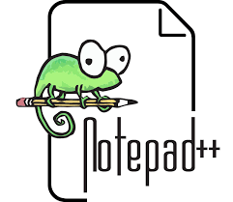
Notepad++
The classic go-to for Windows users.
It is extremely basic, making it great for beginners who just want to open a file quickly without dealing with complex developer environments.

Slide 6
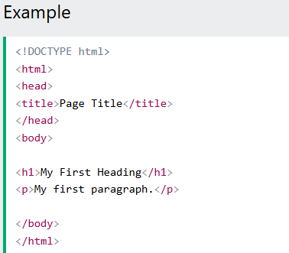

Slide 7
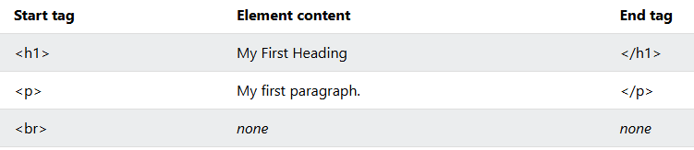

Slide 8
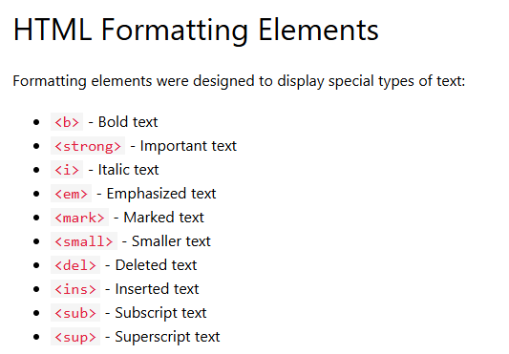
HTML Text Formatting

Slide 9
Activity
<b> - Bold text
<strong> - Important text
<i> - Italic text
<em> - Emphasized text
<mark> - Marked text
<del> - Marked text
<small> - Smaller text
<ins> - Inserted text
<sub> - Subscript text
<sup> - Superscript text

Slide 10

Practice Hands-on Activity
Apply the HTML Text Formatting.
<b> - complete name
<strong> - your section
<i> - school name
<em> - school address
<mark> - favorite sports
<del> - favorite food
<small> - favorite place
<ins> - favorite spot
<sub> - H₂O, CO₂
<sup> - 37⁰, 30°C (86°F)

